Slide 1
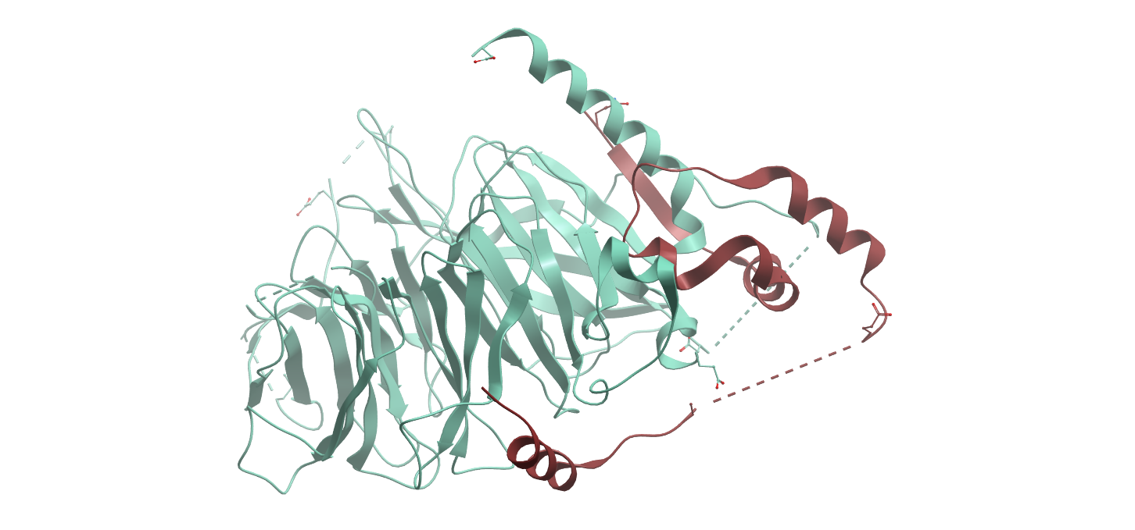
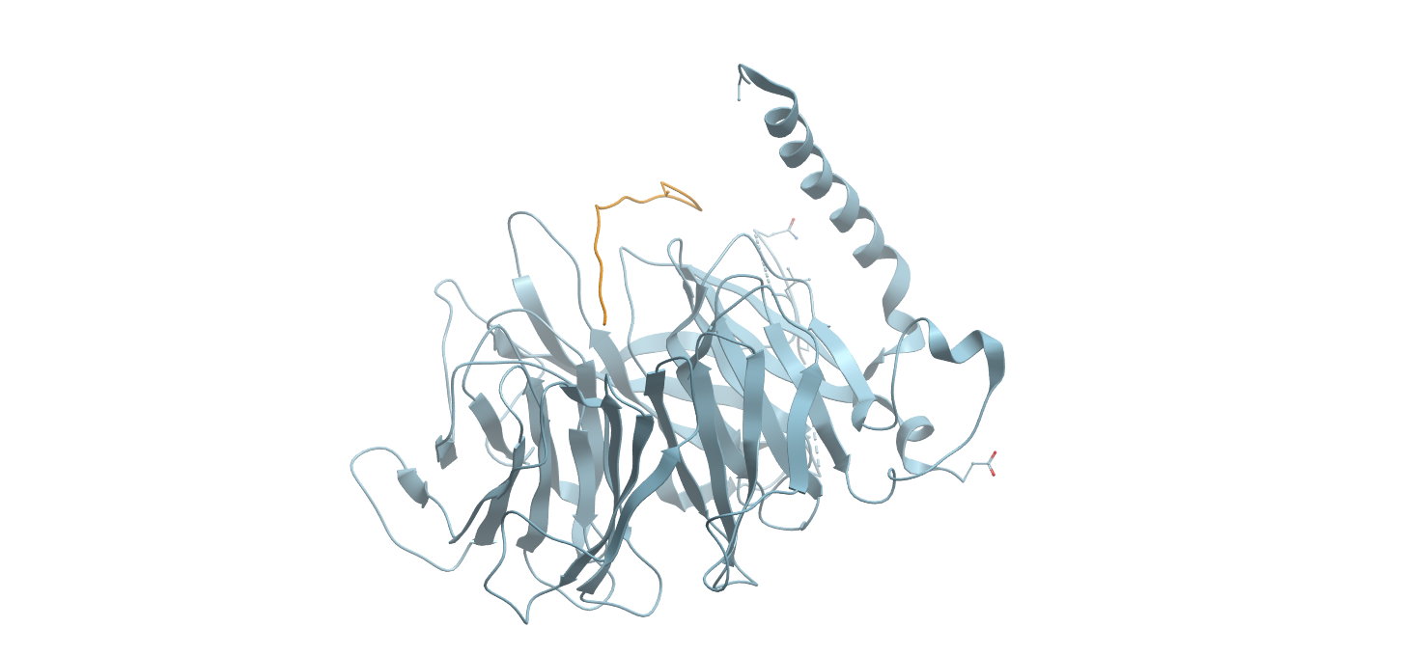
RBBP4 FP assay
MTA1 peptide Side Pocket
H3 peptide Top Pocket
Medium throughput screening afforded low-microM hits for the top pocket
Hits confirmed by FP and SPR.
Masoud Vedadi

Slide 2
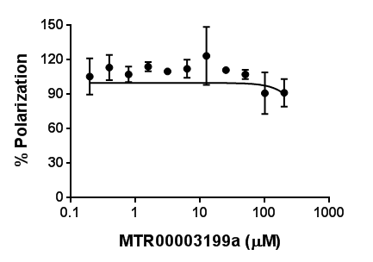
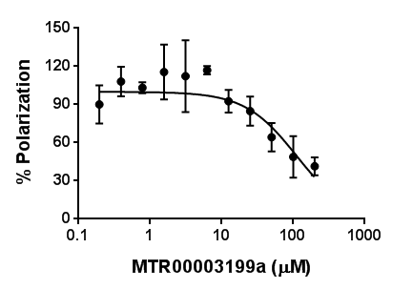
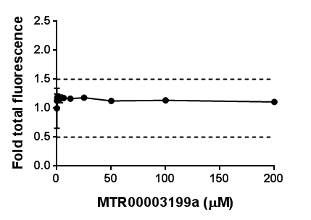
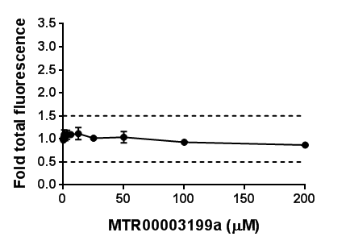
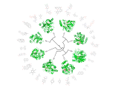

OICR0017251A01/ MTR00003199 : Confirmed by FP assay (Top pocket)
SGC Id |  | MTR00003199a
OICR Id |  | OICR0017251A01
Titration range |  | 0.2-200 µM
RBBP4-MTA (656-686) |  |  |  | RBBP4-H3 (1-21)
Top=100, Bottom=0
K_{disp} (µM) |  | Hill slope |  | K_{disp} (µM) | 110 | Hill slope | -1.2
* Valid range for Fold total fluorescence deviation: 0.5-1.5
Molecular Biophysics

Slide 3
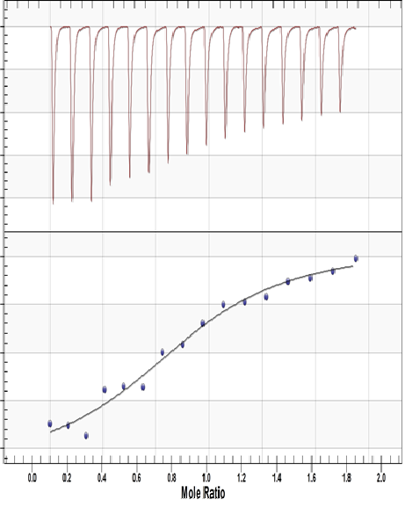
OICR0017251A01/ MTR00003199 Binds to RBBP4: Confirmed by ITC
Time (s)
1 500 1000 1500 2000 2500 3000
0
-0.5
-1.0
-1.5
-2.0
Corrected Heat Rate (µJ/s)
-20
-25
-30
-35
-40
OICR0017251A01/ MTR00003199
ITC Conditions:
RBBP4 was dialyzed for 2 hours at 4°C and then centrifuged at 8,000 rpm for 10 minutes to remove any precipitations. 16 injections of 3 μL each in 180 s intervals were performed.
In Syringe: 20 mM HEPES pH 7.4, 150 mM NaCl, 0.005% Tween 20, compound concentration of 0.5mM and DMSO Concentration 1%.
Enthalpy and Fit (K J/mol)
K_{d} = 13µM
n = 0.9
∆H (K J/mol) = -23.07
∆S (J/mol.K) = 15.91

Slide 4
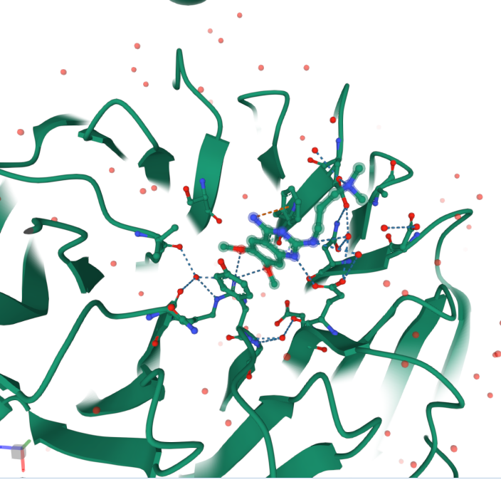
Co-crystal structure with the Hit (PDB ID = 7M40)
https://www.rcsb.org/3d-view/7M40?preset=ligandInteraction&label_asym_id=C

